Slide 1
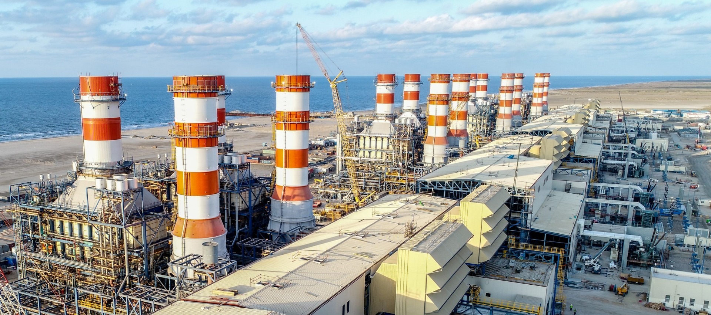
Energy
Production
Prediction

Slide 2

Business Objective
A combined-cycle power plant comprises gas turbines, steam turbines, and heat recovery steam generators. In this type of plant, the electricity is generated by gas and steam turbines combined in one cycle. Then, it is transferred from one turbine to another. We have to model the energy generated as a function of exhaust vacuum and ambient variables and use that model to improve the plant's performance.

Slide 3
Data Set Details
Temperature : In degrees Celsius.
Exhaust Vacuum : In cm Hg.
Ambient Pressure : In millibar.
Relative Humidity : In percentage.
Energy Production : In MW, net hourly electrical energy output.

Slide 4
Data Preprocessing
Checking for Duplicated Values
Visualizing
Correlation Analysis
Outlier Detection
Exploratory
Data
Analysis

Slide 5
Descriptive
Statistics
Typecasting
Data
Preprocessing
Missing Value
Imputation
Unique Values

Slide 6
Descriptive Statistics
 | Temperature | Exhaust vacum | Amb pressure | R humidity | Energy production
count | 9568.000000 | 9568.000000 | 9568.000000 | 9568.000000 | 9568.000000
mean | 19.651231 | 54.305804 | 1013.259078 | 73.308978 | 454.365009
std | 7.452473 | 12.707893 | 5.938784 | 14.600269 | 17.066995
min | 1.810000 | 25.360000 | 992.890000 | 25.560000 | 420.260000
25% | 13.510000 | 41.740000 | 1009.100000 | 63.327500 | 439.750000
50% | 20.345000 | 52.080000 | 1012.940000 | 74.975000 | 451.550000
75% | 25.720000 | 66.540000 | 1017.260000 | 84.830000 | 468.430000
max | 37.110000 | 81.560000 | 1033.300000 | 100.160000 | 495.760000

Slide 7
Typecasting
Column | Non-Null Count | Dtype
Temperature | 9568 non-null | float64
Exhaust vacuum | 9568 non-null | float64
Amb pressure | 9568 non-null | float64
R humidity | 9568 non-null | float64
Energy production | 9568 non-null | float64

Slide 8
Missing Value
Imputation
temperature has 0% missing value(0)
exhaust_vacuum has 0% missing value(0)
amb_pressure has 0% missing value(0)
r_humidity has 0% missing value(0)
energy_production has 0% missing value(0)

Slide 9
Unique Values
Temperature
All Unique Value in temperature
[ 1.81 2.34 2.58 ... 35.56 35.77 37.11]
Total no of unique values 2773
Exhaust vacuum
All Unique Value in exhaust_vacuum
[25.36 25.88 34.03 34.69 35.19... 79.74 80.18 80.25 81.56]
Total no of unique values 634

Slide 10
Amb pressure
All Unique Value in amb_pressure
[ 992.89 993.11 993.31 ... 1033.25 1033.29 1033.3 ]
Total no of unique values 2517
R humidity
All Unique Value in r_humidity
[ 25.56 25.89 26.3 ... 100.14 100.15 100.16]
Total no of unique values 4546
Energy production
All Unique Value in energy_production
[420.26 421.57 425.11 ... 495.24 495.35 495.76]
Total no of unique values 4836

Slide 11
Checking for
Duplicated Values
There are 41 Duplicate Value’s.
Dropping Duplicated Value’s We Lost 0.43% Data.
After Dropping And Re-index Are Dataset Shape is 9527 rows × 5 columns

Slide 12
Temperature
Exhaust Vacuum
Data
Visualizing
Ambient
Pressure
Relative
Humidity

Slide 13
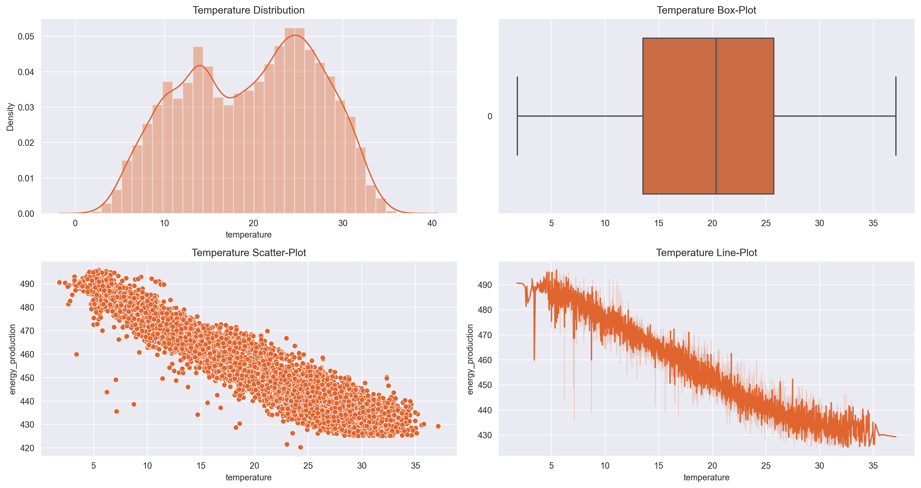
Temperature

Slide 14
Temperature
The distribution of the temperature column is not uniform.
There are no outliers in the temperature column.
A -0.95 correlation value is present for the temperature column.
As shown by the line graphic, energy production falls down as the temperature rises.

Slide 15
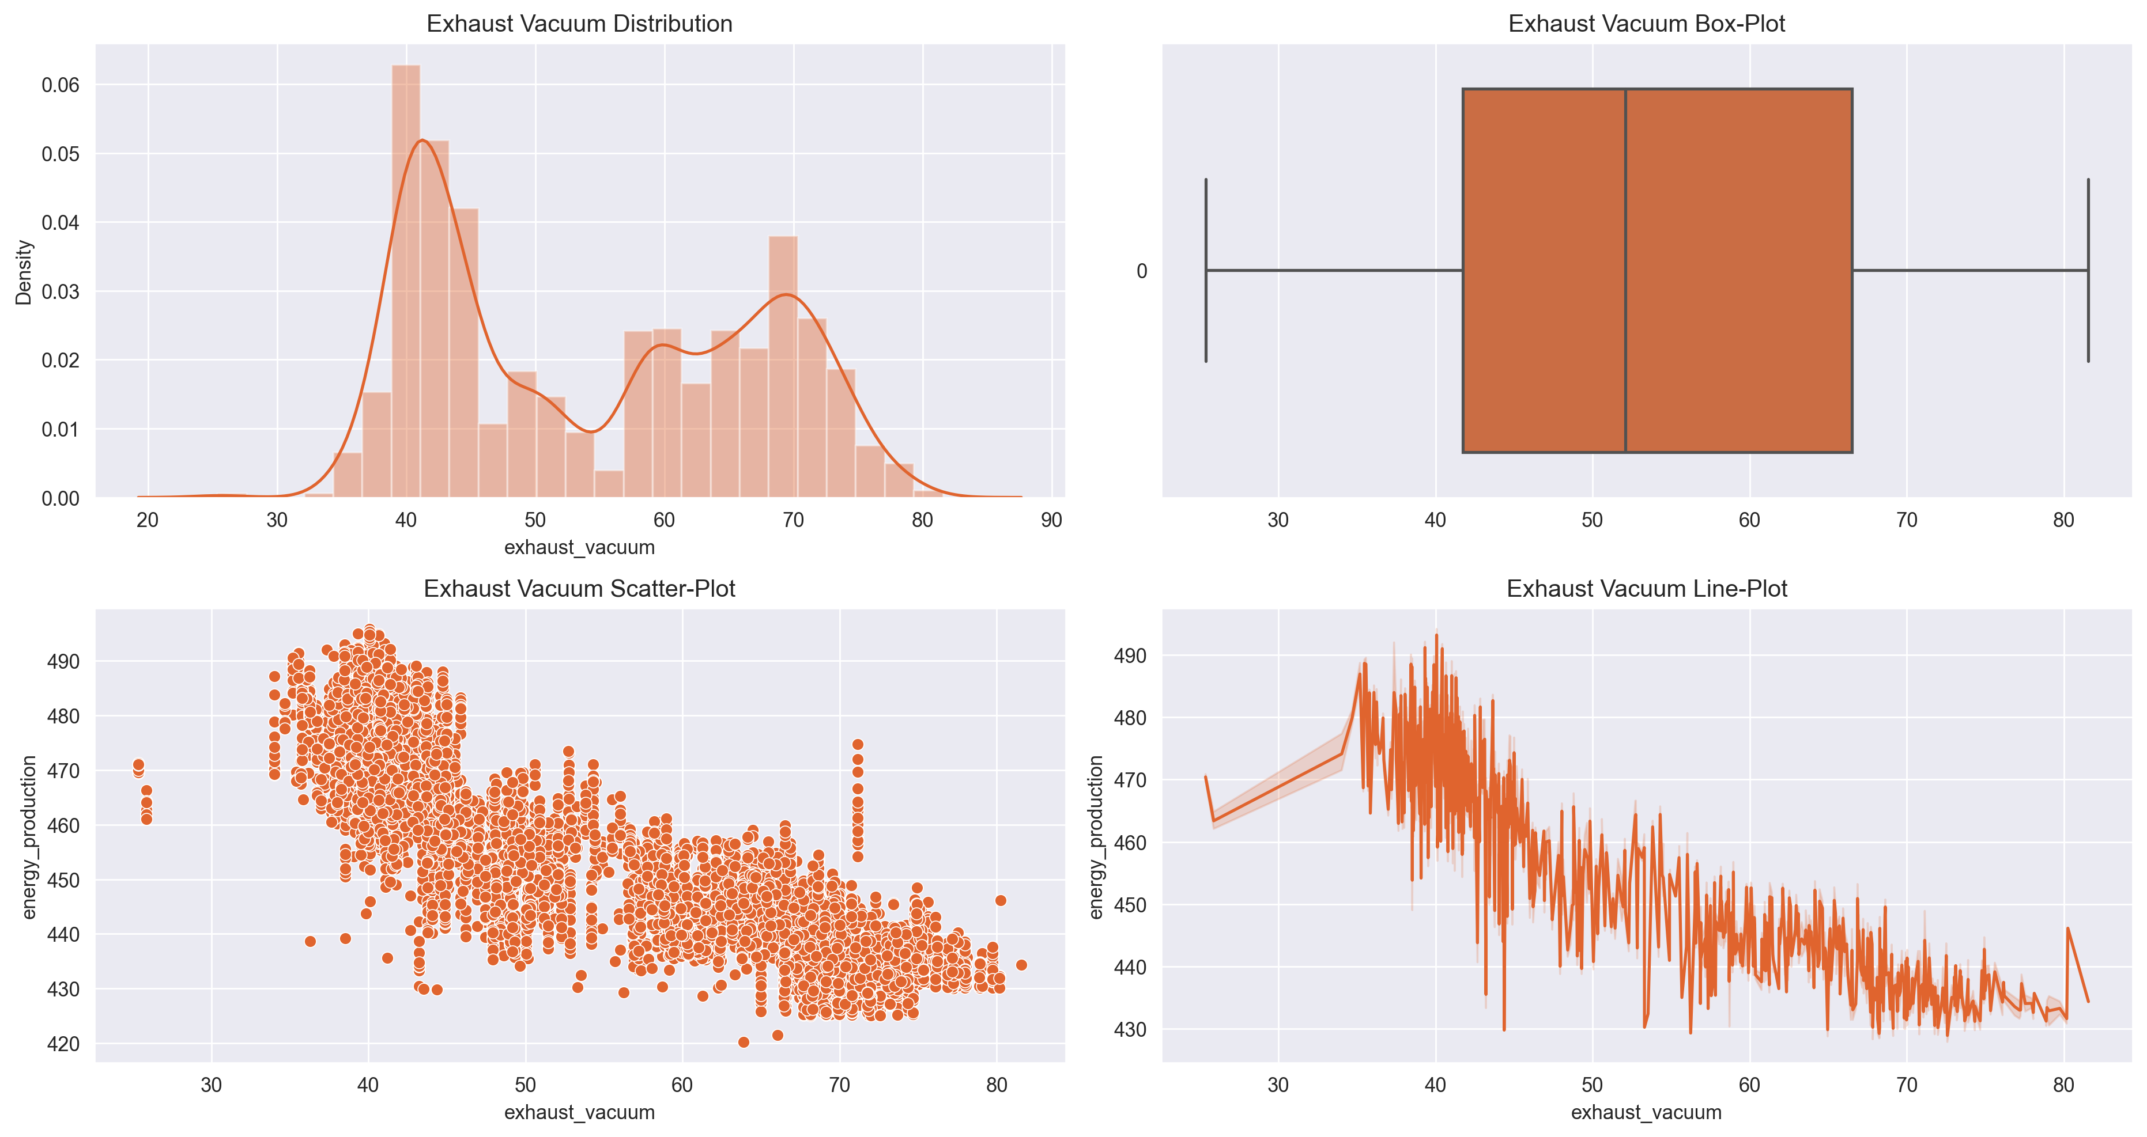
Exhaust Vacuum

Slide 16
Exhaust Vacuum
The distribution of the exhaust vacuum column is not uniform.
There are no outliers in the exhaust vacuum column.
A -0.87 correlation value is present for the exhaust vacuum column.
According to the exhaust vacuum column, energy production grows from 10 to 40, which declines as the exhaust output keeps rising.

Slide 17
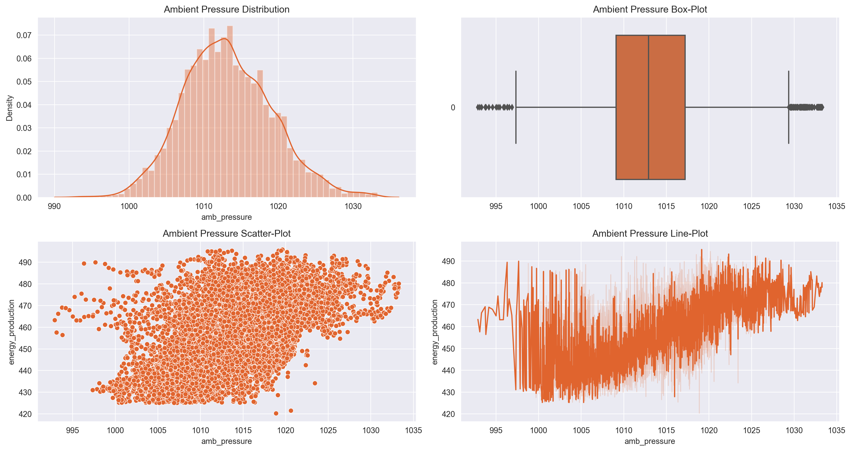
Ambient Pressure

Slide 18
Ambient Pressure
The distribution of the ambient pressure column is a normal distribution.
There are 0.96% outliers in the ambient pressure column.
A 0.52 correlation value is present for the ambient pressure column.
From 998, ambient pressure reduces energy output until it reaches 1010, at which point production starts to climb until 1025, after which it remains at the same level.

Slide 19
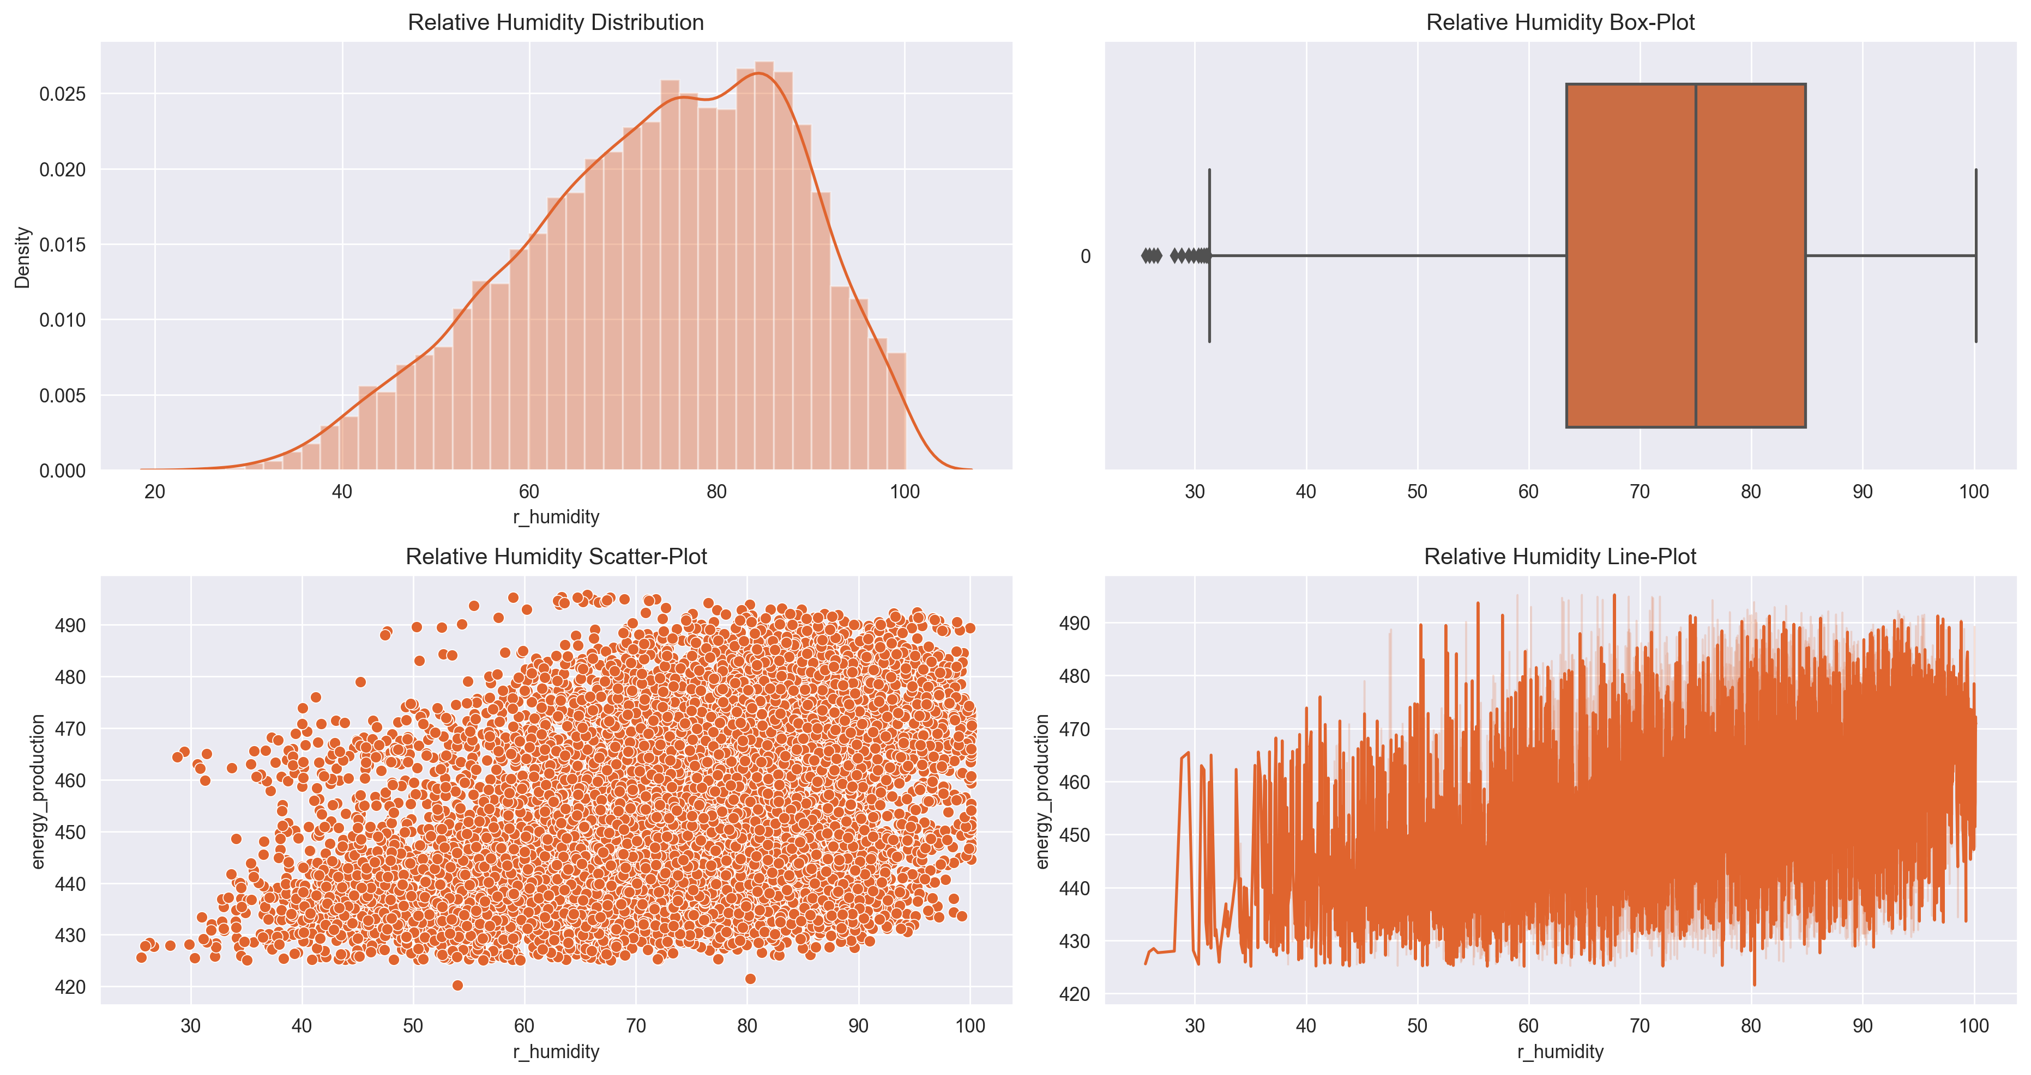
Relative Humidity

Slide 20
Relative Humidity
The distribution of the ambient pressure column is left-skewed.
There are 0.14% outliers in the ambient pressure column.
A 0.39 correlation value is present for the ambient pressure column.
Energy generation is unaffected by relative humidity.

Slide 21
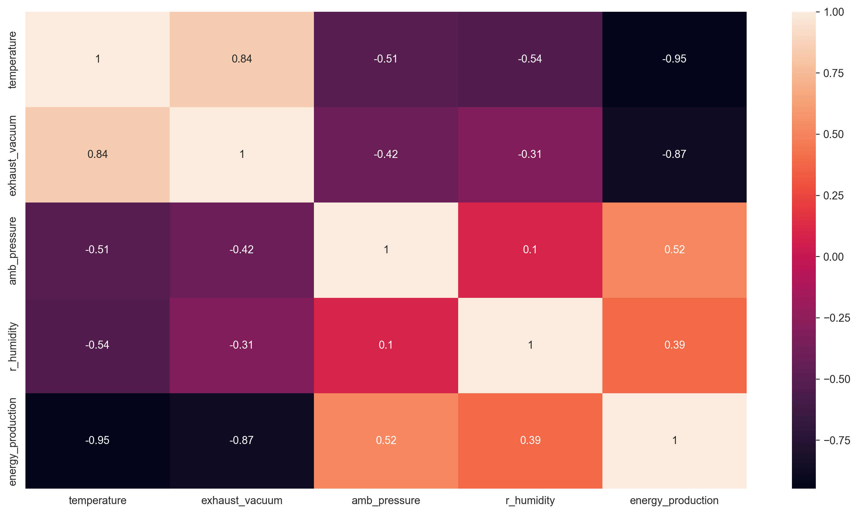
Correlation
Matrix

Slide 22
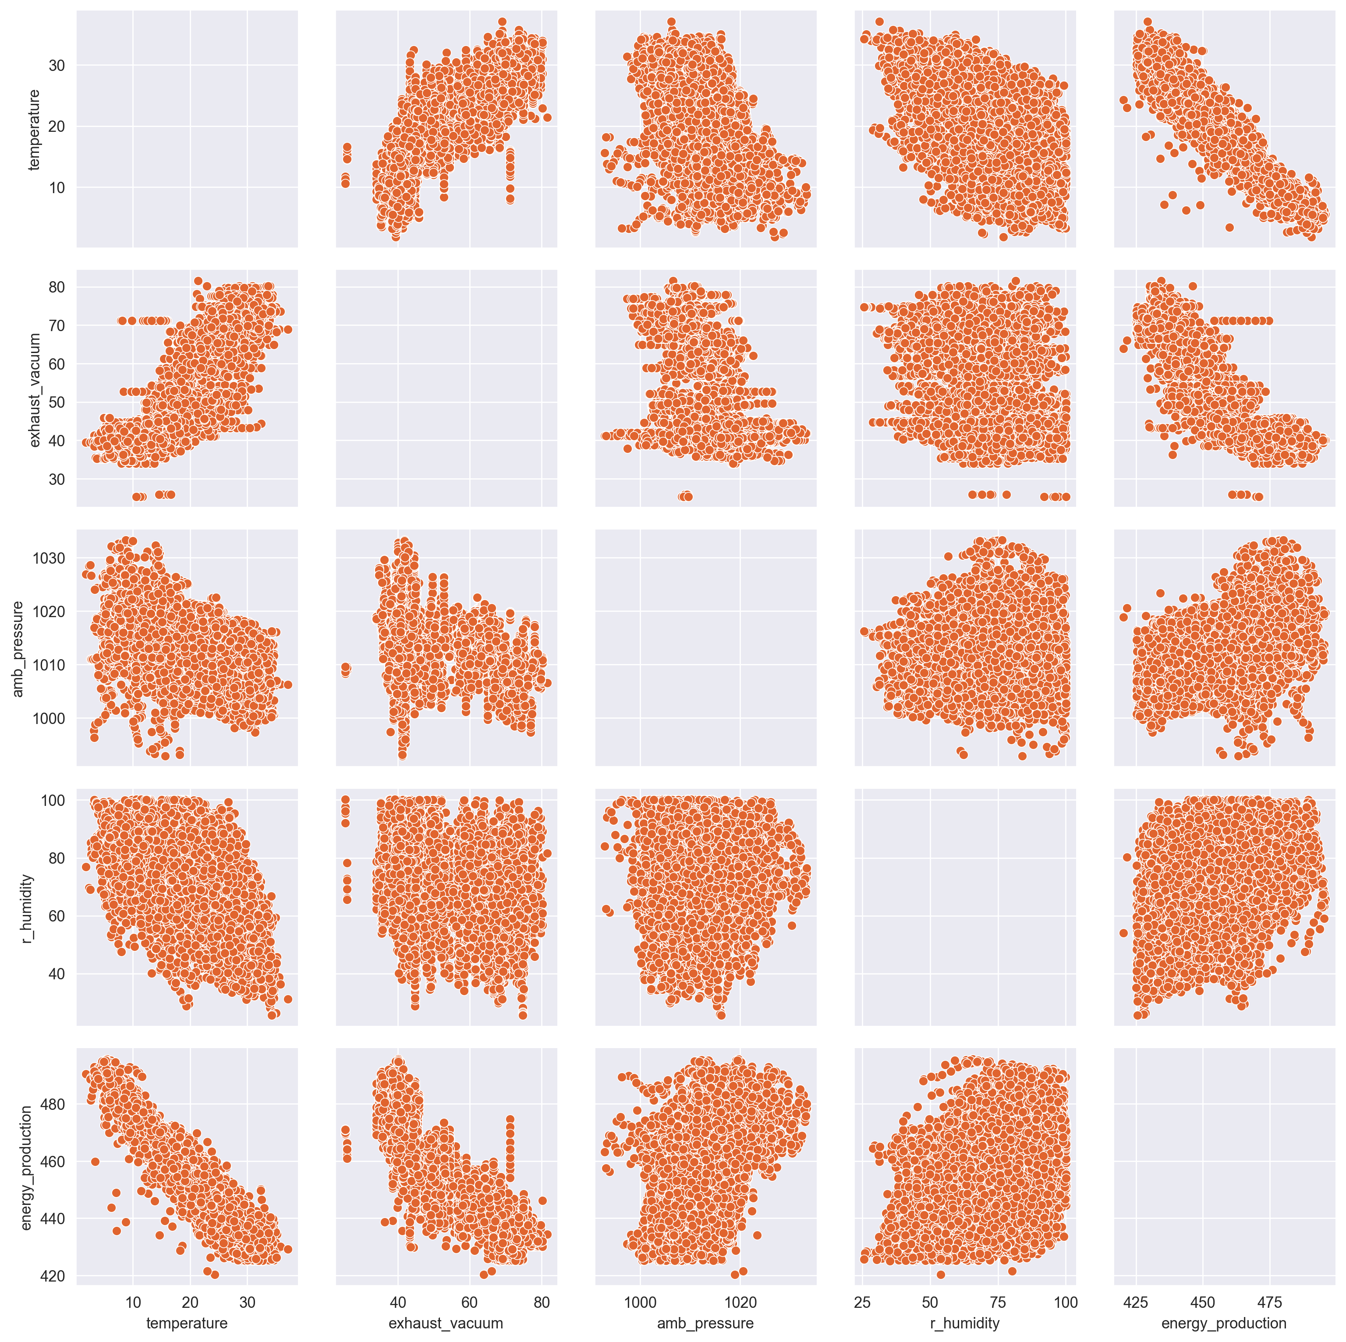
Pair-Plot

